Slide 1


Team : Kapil Verma, Abhinav Mallik, Akshay Khanna
Used : HANA Cloud Database, SAPUI5, HTML5
iRescue

Slide 2


Trigger
Event can be triggered By User
Event can be triggered Band ( low or extremely high hear rate)
Decide
Used Machine learning K-Means Nearest neighbor Algorithm Finds to out nearest hospital & nearest hospitals.
And to Checks availability & any medical plan opted by user.
Send
Send User details to hospital(online form).
The contact details of hospital & ambulance is shared to relatives.
Both Hospital & relatives can track ambulance.
A new ambulance is assigned in case of connection loss of more than 10 minutes.
Track
Flow of Control

Slide 3
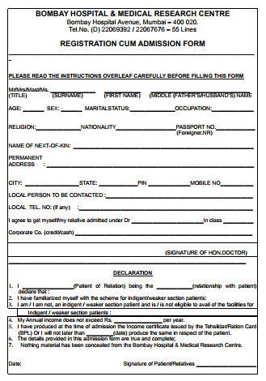


Say NO to Forms
Decide & Assign
We use HANA Cloud as Database :
Hospital Send Bed Availability to Hana Cloud DB, in existing Block.
Ambulance send Location to Hana Cloud DB, in existing Block.
Casualty Send Data to Hana Cloud DB.
Our Bot analyze all that the location of user, finds nearest hospital, nearest hospital, choose those who comes under is covered hospital otherwise choose nearest one.
Checks availability of beds in hospital, if everything met, sends hospital location & user location to ambulance.

Slide 4
Decide Assign Broadcast
We use HANA Cloud as Database :
Once allotment done it sends the hospital names, contact detail, ambulance number, driver number, location & name of hospital to relatives.
Sends filled form to Hospital with ambulance details.
Ambulance Tracking
User, relative & hospital can track ambulance.
If Ambulance stops sending location or stops for 5 minutes, raise alert.
If still after 10 minutes no response, assigns a new nearest ambulance to user.
We used a machine learning in Ambulance tracking , bot tracks the places where usually signal get lost or where there are stoppage usually. So whenever, ambulance go
Updated Data is sent to hospital as well relatives.

Slide 5
Why Ambulance Tracking ?
Only 59% of Indian emergency ambulances arrive w/i response parameters '108 ambulance failed to reach patients on time' - The Times of India
Fake calls by ambulance service to get payments: RTI report - The Times of India Fake calls by ambulance service to get payments: RTI report - The Times of India
Flat tyre in ambulance leaves accident victim stranded - The Times of India on Mobile Flat tyre in ambulance leaves accident victim stranded - The Times of India
‘108’ ambulance is no more a poor man’s vehicle - The Times of India ‘108’ ambulance is no more a poor man’s vehicle - The Times of India
India: "In past 2 years, at least 13 ambulance drivers have been booked for drunken driving" Rogue ambulance drivers menace city roads, public - The Times of India

Slide 6
Future
Company Portals will be integrated, for easier access.
Government alerts regarding, health campus, any spreading disease etc.
Option to locate free health care clinics nearby with there opening closing details & rating.
Adding cost as factor of choosing the hospital, categorizing them as cheap, medium, expensive choosing it as per user’s choice opted in form.
Rating the ambulance service.

Slide 7



© 2017 Infosys Limited, Bangalore, India. All Rights Reserved. Infosys believes the information in this document is accurate as of its publication date; such information is subject to change without notice. Infosys acknowledges the proprietary rights of other companies to the trademarks, product names and such other intellectual property rights mentioned in this document. Except as expressly permitted, neither this documentation nor any part of it may be reproduced, stored in a retrieval system, or transmitted in any form or by any means, electronic, mechanical, printing, photocopying, recording or otherwise, without the prior permission of Infosys Limited and/ or any named intellectual property rights holders under this document.

